Slide 1

CENG 789 – Digital Geometry Processing
06- Surface Reconstruction,
Scientific Visualization and Info Visualization
(scalar, vector fields) (MDS, protein)
Assoc. Prof. Yusuf Sahillioğlu
Computer Eng. Dept, , Turkey

Slide 2
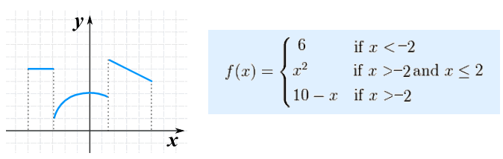
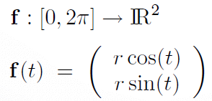
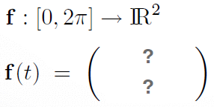


Explicit Representation
<number> / 98
RECALL: Polygon meshes are piecewise linear surface representatins.
Analogous to piecewise functions:
Think surface as (the range of) a “shape” function.
vs.

Slide 3
Explicit Surface Representation
<number> / 98
For varying t, we get 2D shape (circle) points: t in [0, 2pi].
Parameterization f maps a 1D parameter domain, e.g., [0, 2pi], to the curve (surface) embedded in R² (R³).

Slide 4

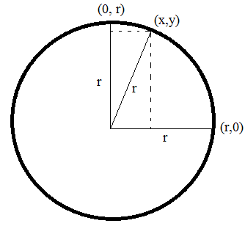
Implicit Surface Representation
<number> / 98
Implicit or indirect surface representation.
Surface is defined to be the zero-set of a scalar-valued function F.
  That is, we have , and then surface .
  Circle of radius r:
  is defined by (x,y) pairs
  that make the right-hand-side 0

Slide 5

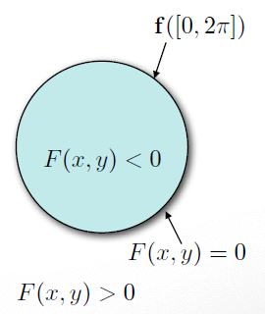

Explicit vs. Implicit
<number> / 98
Explicit:
  Range of a parameterization function.
Implicit:
  Kernel of an implicit function.

Slide 6
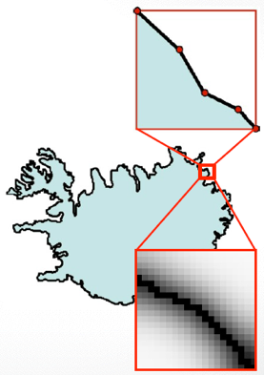
Explicit vs. Implicit
<number> / 98
Explicit: for non-mathematical/arbitrary shapes. (direct point)
  Range of a parameterization function.
  Piecewise approximation.
Implicit: for non-mathematical/arbitrary shapes.
  Kernel of an implicit function.
  Piecewise approximation.
  (zero-set)

Slide 7
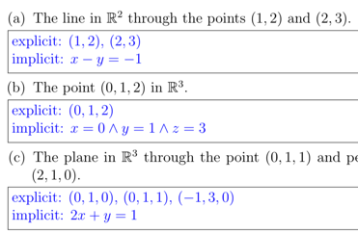
Explicit vs. Implicit
<number> / 98
Explicit:
  Range of a parameterization function.
  Piecewise approximation.
  Splines, triangle meshes, points.
  Easy rendering.
  Easy geom. modif. (deformation or new t).
Implicit:
  Kernel of an implicit function.
  Piecewise approximation.
  Scalar-valued 3D grid (mesh lies here).
  Easy in/out test (just evaluate F).
  Easy topology modification.
Notes:
Easy topology modification: structure of F, e.g., voxel grid, is independent from the topology of the level-set surface; hence we can easily change surface topology/connectivity.

Slide 8
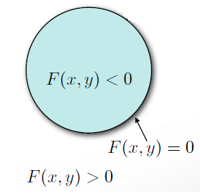
Implicit/Indirect Surfaces
<number> / 98
Level-set of a function defines the shape.
Level means function values are the same = at the same level. Traditionally, level is 0, hence 0-set of the function F is sought.

Slide 9
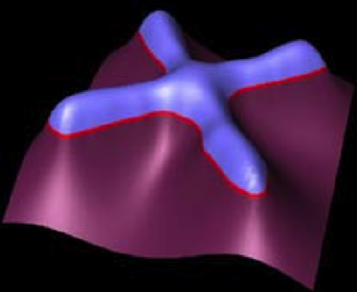
Implicit Surfaces
<number> / 98
Level-set of 2D function F(x, y) defines 1D curve (embedded in 2D).

Slide 10
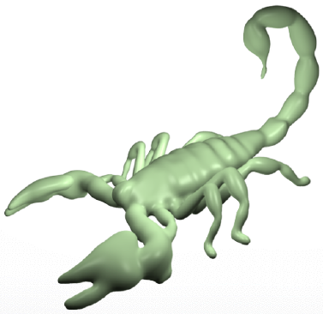
Implicit Surfaces
<number> / 98
Level-set of 3D function F(x, y, z) defines 2D surface (embedded in 3D).

Slide 11

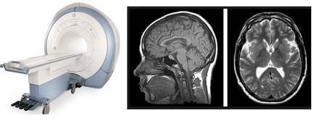
Implicit Function F
<number> / 98
Most common and natural representation is Signed Distance Function.
Maps each 3D point x to its signed distance F(x) from the surface.
Sign indicates inside/outside. F(x)=0 means x is on the surface.
Other than Signed Distance Function (SDF), continuous intensity function from CT/MRI scans are also common. Here, we will focus on the computation of SDF as it is a geometric problem. CT/MRI devices provide intensity info with their underlying radiologic technology.

Slide 12
Implicit Function F
<number> / 98
Most common and natural representation is Signed Distance Function.
Maps each 3D point x to its signed distance F(x) from the surface.
Sign indicates inside/outside. F(x)=0 means x is on the surface.
Other than Signed Distance Function (SDF), continuous intensity function from CT/MRI scans are also common. Here, we will focus on the computation of SDF as it is a geometric problem. CT/MRI devices provide intensity info with their underlying radiologic technology.
  Intensity: amount of vibration caused by magnets in MRI (no radiation).
  Intensity: x-rays (x radiation) are beamed & received along the tunnel in CT.

Slide 13
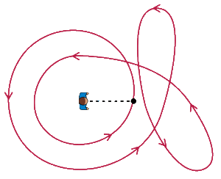
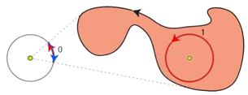
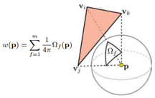

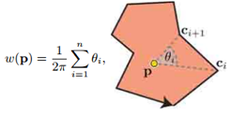
Implicit Function F
<number> / 98
Most common and natural representation is Signed Distance Function.
Maps each 3D point x to its signed distance F(x) from the surface.
Sign indicates inside/outside. F(x)=0 means x is on the surface.
Another function for inside/outside test: Winding/Turning Numbers.
W=2
https://twitter.com/i/status/1232826293902888960

Slide 14
Implicit Function F
<number> / 98
Most common and natural representation is Signed Distance Function.
Maps each 3D point x to its signed distance F(x) from the surface.
Sign indicates inside/outside. F(x)=0 means x is on the surface.
Another function for inside/outside test: Winding/Turning Numbers.
Originally defined for closed curves (2D) and surfaces (3D).
Made robust to self-intersections, open boundaries, and non-manifold pieces by Jacobson et al., 2013.
Still needs some sort of surface input (tests point in/out of a surface), so not suitable for point cloud to surface conversion.
Notes:
Jacobson et al.: Robust Inside-Outside Segmentation using Generalized Winding Numbers paper for details on winding numbers.

Slide 15
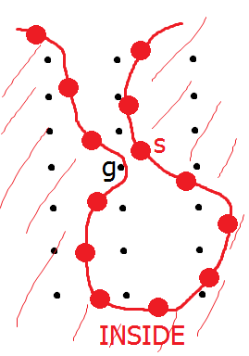
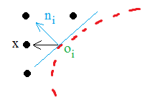
Implicit Function F
<number> / 98
Most common and natural representation is Signed Distance Function.
Maps each 3D point x to its signed distance F(x) from the surface.
Sign indicates inside/outside. F(x)=0 means x is on the surface.
Another function for inside/outside test: Winding/Turning Numbers.
  More robust than a signed distance function.
  Although inside, grid point g will be wrongly treated
  as outside as it is coupled w/ the closest sample,
  which yields a positive signed distance (see slide 39).
  No such problem w/ Winding Number test.
  F(x) = (x - o_{i}) . n_{i}

Slide 16
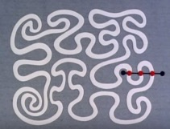
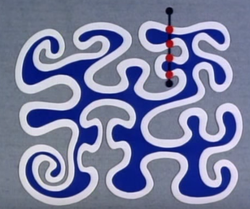
Implicit Function F
<number> / 98
Most common and natural representation is Signed Distance Function.
Maps each 3D point x to its signed distance F(x) from the surface.
Sign indicates inside/outside. F(x)=0 means x is on the surface.
Another function for inside/outside test of a closed surface: ray count.
Shooting a ray from the point and count # of times it intersects the surface: odd number means the point is inside, even means outside.

Slide 17

Implicit Function F
<number> / 98
Most common and natural representation is Signed Distance Function.
Maps each 3D point x to its signed distance F(x) from the surface.
Sign indicates inside/outside. F(x)=0 means x is on the surface.
A function for unsigned distance to a point cloud: UDF vs. SDF.
Average the sum of squared distances to K-nearest neighbors.
Doesn’t need a surface input and also pretty robust ☺.
Can you sign this up to make it useful for Marching Cubes?
  First do UDF (robust) and then sign it using the signs (not values) in SDF?

Slide 18
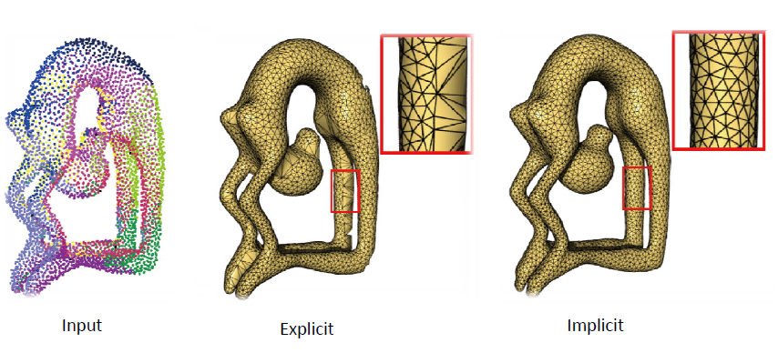
Surface Reconstruction
<number> / 98
Given a set of 3D points, compare Explicit vs. Implicit reconstruction.
Implicit algorithms approximate, explicit ones interpolate input data.

Slide 19

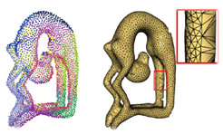
Surface Reconstruction
<number> / 98
Given a set of 3D points, compare Explicit vs. Implicit reconstruction.
Explicit reconstruction method:
  Connect sample points by triangles (connect the dots).
  Exact interpolation of sample points.
  Bad for noisy or misaligned data (common in scans).
  May lead to holes or non-manifoldness.

Slide 20
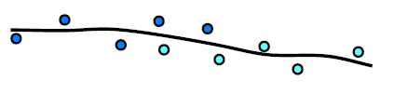
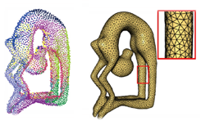
Surface Reconstruction
<number> / 98
Given a set of 3D points, compare Explicit vs. Implicit reconstruction.
Implicit reconstruction method:
  Estimate signed distance function (SDF) for each grid point (scalar-valued grid).
  Extract level zero iso-surface from this grid (Marching Cubes).
  Approximation of input points (better in noisy situations).
  Manifoldness by construction.

Slide 21
Surface Reconstruction
<number> / 98
Given a set of 3D points, compare Explicit vs. Implicit reconstruction.
Implicit reconstruction method:
  The distance function is interpolated and polygonalized by the marching squ/cubes algorithm.
  The distance function is, however, based on an approximation of the input surface (via tangent planes), hence the whole process is an approximation.

Slide 22
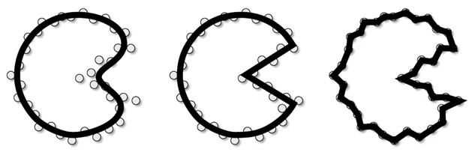
Surface Reconstruction
<number> / 98
Given a set of 3D points, compare Explicit vs. Implicit reconstruction.
Implicit vs. Explicit:
Smooth Piecewise Smooth Interpolant
“Connect the Dots”
Surface reconstruction is an ill-posed problem: want sharp corner?
Solution: regularize via priors, e.g., smooth, piecewise smooth, simple.

Slide 23
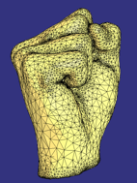
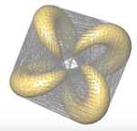
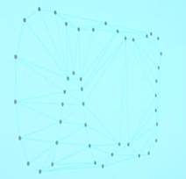
Explicit Reconstruction
<number> / 98
Crust Algorithm: Since Delaunay triangulation encodes the proximity b/w the points, if points are dense enough, we should have the desired triangles within the Delaunay triangulation. Tri → Tetrahedron in 3D.
Compute Delaunay triangulation of the input point set.
So we have the edges we need, but also the extras.

Slide 24
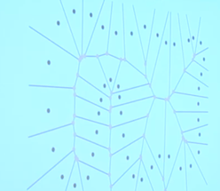
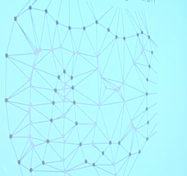
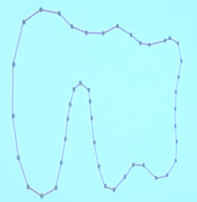
Explicit Reconstruction
<number> / 98
Crust Algorithm: Since Delaunay triangulation encodes the proximity b/w the points, if points are dense enough, we should have the desired triangles within the Delaunay triangulation. Tri → Tetrahedron in 3D.
Get rid of extras: Compute Voronoi diagram. Insert Voronoi vertices (pink) to the Delaunay triangulation. Keep edges b/w black dots only.
Notes:
Details: https://youtu.be/PWlo7PvtQVw?t=2790 or in the Crust paper A New Voronoi-Based Surface Reconstruction Algorithm.

Slide 25
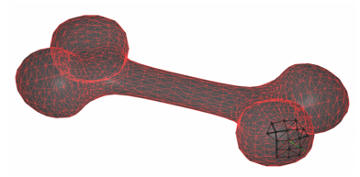
Explicit Reconstruction
<number> / 98
Find local neighborhood L_{i} of each point p_{i} in the 3D point cloud input.
  Closest k points (using a k-d tree).
For each L_{i} compute tangent plane using PCA.
  If the input is oriented, just take the average of all normals for the plane normal. Use the mean pnt as the plane pnt (for both oriented/unoriented).
Project all points in L_{i} to the tangent plane and compute their 2D Delaunay triangulation D_{i}.
Final triangulation is the composition of all these local triangulations.
Yet another explicit algorithm is Poisson Reconstruction.

Slide 26
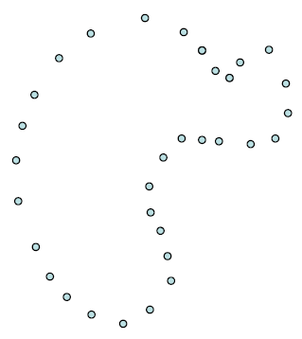
Implicit Reconstruction
<number> / 98
Implicit function approach.

Slide 27
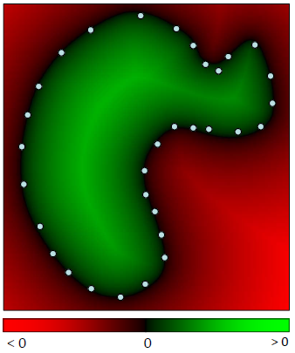
Implicit Reconstruction
<number> / 98
Implicit function approach.
Define a function F : R³ → R with value <0 outside, >0 inside, =0 on.

Slide 28
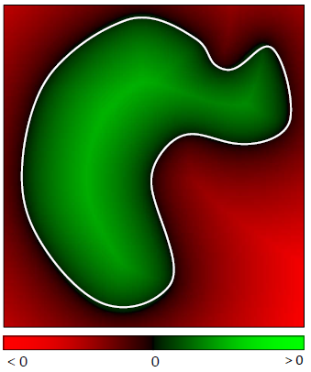
Implicit Reconstruction
<number> / 98
Implicit function approach.
Extract the zero-set isosurface, i.e., S = {x in R³ | F(x) = 0 }.

Slide 29
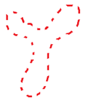
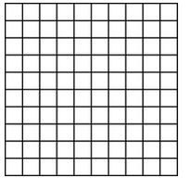
Implicit Reconstruction
<number> / 98
Implicit function: Signed distance function F : R³ → R.
Construction algorithm.
  Input: point samples representing the object to be reconstructed.
  Output: F value at each grid point, i.e., signed distance of that grid pnt to the sampled surface.

Slide 30
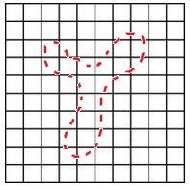
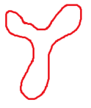
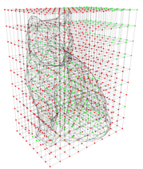
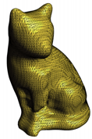
Implicit Reconstruction
<number> / 98
So we need a grid that encapsulates the sampled surface.
Uniform 2D grid.
  Mesh to be extracted: 1D (closed) curve →
Uniform 3D grid.
  Mesh to be extracted: 2D (closed) surface →→→→

Slide 31
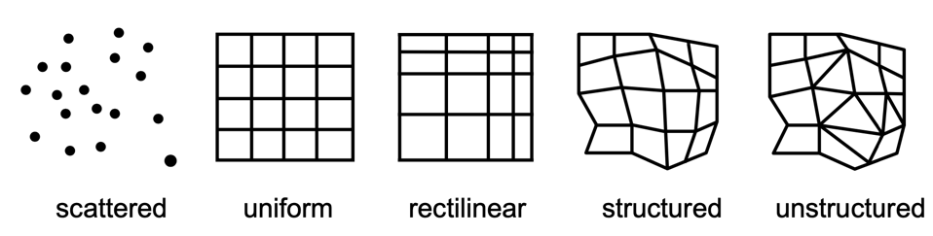
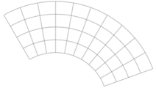
Implicit Reconstruction
<number> / 98
Other grid types.
Not a grid at all: no connectivity.
Uniform aka regular grid.
curvilinear

Slide 32
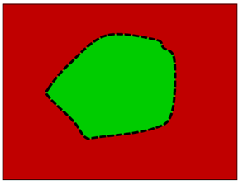
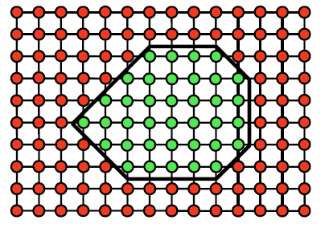
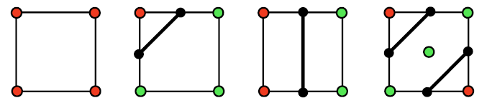
Marching X
<number> / 98
Mesh extraction idea.
Marching Squares (2D), Marching Cubes (3D).
2⁴ cases. May be reduced by symmetry, e.g., all red and all gre. equal.

Slide 33
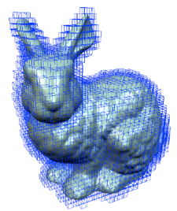
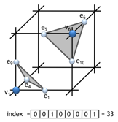
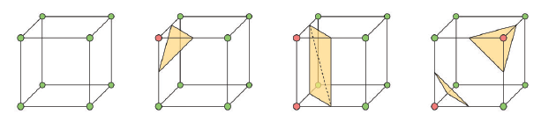
Marching X
<number> / 98
Mesh extraction idea.
Marching Squares (2D), Marching Cubes (3D).
2⁸ cases. Sym. applies. Fast look up: use 8-bit case index:

Slide 34
Marching X
<number> / 98
Mesh extraction idea.
Marching Squares (2D), Marching Cubes (3D).
2⁸ cases. Sym. applies. Fast look-up: use 8-bit case index:
Case index brings connectivity from the look-up table.
  Cut edges are e1, e4, e5, e6, e9, e10.
  Output triangles are (e1, e9, e4), (e5, e10, e6).

Slide 35

Marching X
<number> / 98
Steps for Marching Squares/Cubes
  Discretize space (use a regular grid enclosing the surface).
  Evaluate signed distance function on grid.
  Classify grid points (inside/outside w.r.t. surface).
  Classify grid edges (one endpoint inside, one outside).
  Compute intersections.
  Connect intersections.

Slide 36
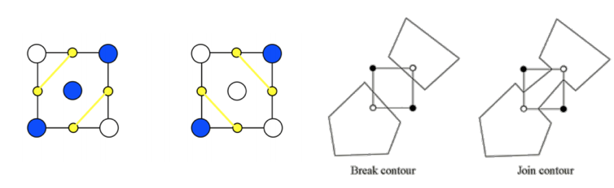
Marching X
<number> / 98
Steps for Marching Squares/Cubes
  Discretize space (use a regular grid enclosing the surface).
  Evaluate signed distance function on grid.
  Classify grid points (inside/outside w.r.t. surface).
  Classify grid edges (one endpoint inside, one outside).
  Compute intersections.
  Connect intersections (ambiguities may arise).
  Handle by subsampling inside a cell, or randomly picking 1 of the 2 possibilities.

Slide 37
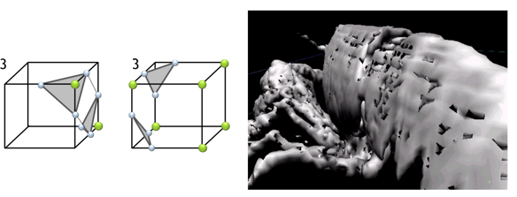

Marching X
<number> / 98
Steps for Marching Squares/Cubes
  Discretize space (use a regular grid enclosing the surface).
  Evaluate signed distance function on grid.
  Classify grid points (inside/outside w.r.t. surface).
  Classify grid edges (one endpoint inside, one outside).
  Compute intersections.
  Connect intersections (ambiguities may arise).
  If random pick, then make choices consistently or this happens. Fixed:

Slide 38


Signed Distance Function (SDF)
<number> / 98
Back to the construction of the Signed Distance Function F : R³ → R.
Input: sample points.
Output: F value at each grid point.
Algo:
  Associate a tangent plane with each sample point.
    Why? Tangent planes are local linear approximations to the surface.
  Compute F(x) = (x - o_{i}) n_{i}

Slide 39



SDF
<number> / 98
Back to the construction of the Signed Distance Function F : R³ → R.
Input: sample points.
Output: F value at each grid point.
  F(x) = (x - o_{i}) n_{i}
F(x) is discontinuous. How to fix? Hint: consider off-set constraints.
  RBF, MLS, DeepSDF, <your idea here>.
    Reconstruction and representation of 3D objects with radial basis functions, 2001.
    Interpolating and Approximating Implicit Surfaces from Polygon Soup, 2004.
    DeepSDF: Learning Continuous Signed Distance Functions for Shape Representation, 2019.

Slide 40




SDF
<number> / 98
Tangent plane for sample point s is found as follows:
  Find k-nearest neighbors of s.
  Apply principle component analysis on this set of close points.
    Find the covariance matrix of the set.
    Take the eigenvectors of this matrix as the principal axes.
    Use the third best axis (w/ smallest eigenvalue) as the normal of the tangent plane, i.e. n_{i}.
    Use the mean of this point set as the centering point of the plane, i.e., o_{i}.
    The smaller the 3rd eigenvalue, the more confident the plane is, a is confident, b,c are not.
    ( )
    Darker = more ambiguous

Slide 41
SDF
<number> / 98
Tangent planes have arbitrary normal signs; need a normal-orienter for smooth/consistent normals across the point set.
MST-based: Surface Reconstruction from Unorganized Points, 1992.
Ray cast-based: A Simple Method for Correcting Facet Orientations, ‘15.
BFS-based: breadth-first search to enfrce a consistent facet orientation.
  Last two are designed for surface/mesh inputs, thus not directly applicable.

Slide 42
k-d Tree for Nearest Neighbors (NN)
<number> / 98
k-nearest points.
Brute force: O(k * N) when we have N samples. //10³ steps
Can be done in O(k * lgN) using k-d trees. //10 steps.
k-d tree: cells are axis-aligned bounding boxes.
  k-d dimensional binary search tree.
  Not to be confused w/ the k in k-nearest neighbors.

Slide 43

k-d Tree for NN
<number> / 98
k-d tree insertion. k = # of dimensions = 2 in example below.
Idea: every time you go down in tree, you toggle decision-making dimension.

Slide 44


k-d Tree for NN
<number> / 98
k-d tree insertion. k = # of dimensions = 2 in example below.
Idea: every time you go down in tree, you toggle decision-making dimension.

Slide 45

k-d Tree for NN
<number> / 98
k-d tree search operation. Search (5, 2) below.
5 > 3 go right, 2 > 1 go right, 5 < 6 go left, 2 < 9 look left, not found.

Slide 46



k-d Tree for NN
<number> / 98
k-d tree partitioning.
Going left or right means partitioning the space.
(3,7) inserted (8,1) inserted (6,6) right of the
3-line, top of the
1-line:
partition the space everything <= 1
into 2 axis-aligned everything > 1
bounding boxes, i.e., (w.r.t. y dimension)
everything <= 3 to left
everything > 3 to right.

Slide 47




k-d Tree for NN
<number> / 98
k-d tree partitioning.
Going left or right means partitioning the space.
(2,6) inserted (1,7) inserted (8,6) inserted (5,9) inserted

Slide 48

k-d Tree for NN
<number> / 98
k-d tree nearest-neighbor to a query point (see Note below).
Idea: As we get closer to the query point, we are cutting out all the subtrees that are away.
Our algo should return point 5 (as the nearest one to the query).
Notes:
Algo:
+ Check distance from point in node to query point.
+ Recursively search left/bottom (if it could contain a closer point) (= cut out).
+ Recursively search right/top (if it could contain a closer point) (= cut out).
+ Organize method so that it begins by searching for a query point (= going towards query).

Slide 49

k-d Tree for NN
<number> / 98
k-d tree nearest-neighbor to a query point.
Idea: As we get closer to the query point, we are cutting out all the subtrees that are away.
Go towards query point, i.e., left. (there might be a closer pnt than 1 in the right; at least we think so now).

Slide 50

k-d Tree for NN
<number> / 98
k-d tree nearest-neighbor to a query point.
Idea: As we get closer to the query point, we are cutting out all the subtrees that are away.
When recursion gets back to pnt 1, we won’t search the right subtree ‘cos there could be no point closer to query than 3. //cutting out ☺

Slide 51

k-d Tree for NN
<number> / 98
k-d tree nearest-neighbor to a query point.
Idea: As we get closer to the query point, we are cutting out all the subtrees that are away.
Going towards the query point, so checking the top of 3. Pnt 6 is not better so do not update the champion.
Notes:
http://youtu.be/1OoM0phlO_U?t=17m55s

Slide 52

k-d Tree for NN
<number> / 98
k-d tree nearest-neighbor to a query point.
Idea: As we get closer to the query point, we are cutting out all the subtrees that are away.
Check left subtree of pnt 6 (going towards qury), empty, so do nothing.

Slide 53

k-d Tree for NN
<number> / 98
k-d tree nearest-neighbor to a query point.
Idea: As we get closer to the query point, we are cutting out all the subtrees that are away.
Do not check the right subtree of pnt 6 ‘cos they can’t be closer than 3.

Slide 54

k-d Tree for NN
<number> / 98
k-d tree nearest-neighbor to a query point.
Idea: As we get closer to the query point, we are cutting out all the subtrees that are away.
Recursion checks the bottom subtree of pnt 3, which takes us to pnt 4, which is not closer; so 3 is still the champion.

Slide 55

k-d Tree for NN
<number> / 98
k-d tree nearest-neighbor to a query point.
Idea: As we get closer to the query point, we are cutting out all the subtrees that are away.
Check left subtree of pnt 4 (towards query), where we have pnt 5, the new champion.

Slide 56

k-d Tree for NN
<number> / 98
k-d tree nearest-neighbor to a query point.
Idea: As we get closer to the query point, we are cutting out all the subtrees that are away.
Check top of pnt 5 (no pnts there), do nothing.

Slide 57
k-d Tree for NN
<number> / 98
k-d tree nearest-neighbor to a query point.
Idea: As we get closer to the query point, we are cutting out all the subtrees that are away.
Check bottom of pnt 5 (no pnts there), do nothing.

Slide 58

k-d Tree for NN
<number> / 98
k-d tree nearest-neighbor to a query point.
Idea: As we get closer to the query point, we are cutting out all the subtrees that are away.
Recursion comes back to the right subtree of pnt 4, but cut it out (no search) ‘cos there can’t be a closer pnt there than pnt 5.

Slide 59

k-d Tree for NN
<number> / 98
k-d tree nearest-neighbor to a query point.
Idea: As we get closer to the query point, we are cutting out all the subtrees that are away.
Recursion comes back to pnt 3, whose both subtrees are handled.

Slide 60

k-d Tree for NN
<number> / 98
k-d tree nearest-neighbor to a query point.
Idea: As we get closer to the query point, we are cutting out all the subtrees that are away.
Recursion comes back to pnt 1, right subtree is next, but cut it out (no search) ‘cos there can’t be a closer pnt there than pnt 5.

Slide 61

k-d Tree Alternative: BSP Tree
<number> / 98
k-d tree: cells are axis-aligned bounding boxes.
BSP-tree: cells are arbitrarily shaped; splitting lines/planes through edge/triangles of the set to be stored. BSP: Binary Space Partitioning.

Slide 62
Marching X
<number> / 98
We efficiently (k-d tree) computed signed distance function F.
The only thing left is to find the intersection point on the square/cube edge:
Square:
Cube:

Slide 63



Marching X
<number> / 98
We efficiently (k-d tree) computed signed distance function F.
The only thing left is to find the intersection point on the square/cube edge:
Square:
Cube:

Slide 64

Marching X
<number> / 98
We efficiently (k-d tree) computed signed distance function F.
The only thing left is to find the intersection point x on the square/cube edge:
F = F₀ * (1-u) + F₁ * u ➔ for F=0, u = F₀ / (F₀ – F₁) //F is linear on edges.
x = x₀ + u * (x₁ – x₀) ➔ use u computed above and locate x ☺.
Interpolation schemes discussed in Deformation lecture slides 26-31.

Slide 65


Marching X vs. Cuberille
<number> / 98
We efficiently (k-d tree) computed signed distance function F.
Once we have this function, one can use the Cuberille method (1979) for a cruder approximation than Marching Cubes (1987).
Check function at each cube center.

Slide 66



Marching Cubes Results
<number> / 98
Size of each voxel in the uniform grid determines level-of-detail.
Grid not adaptive ☹.

Slide 67



Marching Cubes Results
<number> / 98
Size of each voxel in the uniform grid determines level-of-detail.
Grid sampling can cause short triang edges, rendering tri uninformative.

Slide 68



Marching Cubes Results
<number> / 98
Size of each voxel in the uniform grid determines level-of-detail.
Solution: if such an edge arises, snap the edge vertex to cube corner. If more than 1 vertex of a triangle is snapped, then discard triangle.

Slide 69


Marching Cubes Results
<number> / 98
Size of each voxel in the uniform grid determines level-of-detail.

Slide 70

Marching Cubes Case Study: CT Scan View
<number> / 98
In medical imaging, uniform grids are built based on CT/MRI scans.
SDF is replaced by intensity values captured by radiology technology.
CT scans generally come in DICOM format. Here is one way to convert them to NIfTI (nii) format, which can be parsed easily.
  Use dcm2nii.exe software: https://people.cas.sc.edu/rorden/mricron/dcm2nii.html
  E:\Postdoc\skull\mricron>dcm2nii.exe ..\CTsample\DICOM\4821\4823
Unzip output above somescan.nii.gz
Learn target intensity using a software like ITK-SNAP, say it is e.
  E.g., move cursor around skull and read intensities to decide on e.
Marching cubes will extract the level-set corresponding to value e.

Slide 71

Marching Cubes Case Study: CT Scan View
<number> / 98
Read header and data.
  #include "nifti1.h"

Slide 72

Marching Cubes Case Study: CT Scan View
<number> / 98
Read header and data.
  #include "nifti1.h"

Slide 73

Marching Cubes Case Study: CT Scan View
<number> / 98
Create voxels useful to Marching Cubes,
e.g., the ones that contain skull intensities.

Slide 74
Scientific Visualization
<number> / 98
Scalar field: a scalar value is associated with each point in n-d space.
  Can be obtained by associating SDF or intensity values to grid points.
Vector field: an n-d vector is associated with each point in n-d space.
  Can be obtained by simulations.
Scalar fields can be visualized via
  indirect (volume) rendering: isosurface/mesh extraction and rendering
  (corresponding to a certain scalar value – Marching Cubes in 3D).
    We handled this already.
  direct (volume) rendering – ray casting.
    Upcoming.
Vector fields can be visualized via
  vector arrows located at each point.
    Upcoming.

Slide 75
Direct Scalar Field Visualization
<number> / 98
So far we’ve dealt with visualizing a scalar field indirectly, via isosurface extraction and rendering.
Let’s now do it directly via ray casting.
Aka direct volume rendering (DVR) if the field is defined in 3D.

Slide 76


Direct Scalar Field Visualization
<number> / 98
Ray casting is a backward method where we send rays from the eye.
Opposite of the forward method where we use projections to the eye.

Slide 77



Direct Scalar Field Visualization
<number> / 98
Ray casting is similar to ray tracing in surface-based computer graphics.
  Ray tracing deals with primary rays (first rays cast into the scene from the camera/eye) and secondary rays (recursive rays to generate shadows, reflections, refractions, etc.)
    1979, Turner Whitted.
  Ray casting deals only with primary rays.
    1968, Arthur Appel.
Check out CENG477 Computer Graphics course for details.
  http://user.ceng.metu.edu.tr/~ys/ceng477-gfx/
  Look at Ray Tracing parts 1 and 2, up to the Recursive Ray Tracing section.
Additional color due to lighting.

Slide 78

Direct Scalar Field Visualization
<number> / 98
How to calculate ray-surface intersection since we’ve no surfaces here.
Step through the volume.
A ray is cast into the volume, sampling the volume at certain intervals.
Sampling intervals are usually equidistant, but don’t have to be (e.g. importance sampling).
At each sampling location, a sample is interpolated / reconstructed from the voxel grid.
Opacity and color in each cell is predefined according to classification.

Slide 79



Vector Field Visualization
<number> / 98
So far we’ve dealt with visualizing a scalar field, i.e., a grid with function values at each grid point, for a given scalar value.
  Arises frequently in medical imaging, 3D point cloud to surface conversions.
Let’s now extend this to vector field visualization, where we have an n-dimensional space with n-dimensional vectors attached at each point.
  Arises frequently in fluid simulation, air flow simulation, or in general visualizing functions that have the same # of dimensions in their input as in their output.
    f(x, y) = [x² + 5y xy]^{T}, f(x, y, z) = [4x x³(y² – 5) 33] ^{T}, and so on.

Slide 80

Vector Field Visualization
<number> / 98
If all vectors are drawn proportional to their magnitudes, the longer ones mess up the screen.
This one and the subsequent visuals’re collected from the fluid flow youtube series of Khan Academy and 3Blue1Brown.

Slide 81

Vector Field Visualization
<number> / 98
All vectors are made unit (length 1) for visual clarity.
We can still infer their magnitudes via color coding: red long blue short.

Slide 82

Vector Field Visualization
<number> / 98
All vectors are made unit (length 1) for visual clarity.
Combined w/ proper scaling where max length is 1 (prevent mess).

Slide 83


Vector Field Visualization
<number> / 98
Case study: fluid flow.
Droplets of water are moving according to the vectors visualized.
initial state t + 10
Vectors are representing the velocities of particles of fluids here.
  Alternatives: force of gravity, magnetic field, etc.

Slide 84


Vector Field Visualization
<number> / 98
Case study: fluid flow.
Droplets of water are moving according to the vectors visualized.
t t + 10
This is a static vector field depicting a steady state system.

Slide 85


Vector Field Visualization
<number> / 98
Case study: fluid flow.
Vector fields may change over time, e.g., in real-world fluid flow, the velocities of particles change in response to the surrounding context.
t t + 10
This is a dynamic vector field depicting a more realistic fluid flow.
  Wind is not constant; electric field not constant (charged particles move).

Slide 86

Vector Field Visualization
<number> / 98
n-d spaces are equipped with n-d vectors.
So far we studied n=2. Here n=3:
Vectors at each point are defined as f(x, y, z) = [yz xz xy]^{T}.

Slide 87

Vector Field Visualization
<number> / 98
n-d spaces are equipped with n-d vectors.
So far we studied n=2. Here n=3:
Vectors at each point are defined as f(x, y, z) = [1 0 0]^{T}.
y
z
x

Slide 88

Vector Field Visualization
<number> / 98
n-d spaces are equipped with n-d vectors.
So far we studied n=2. Here n=3:
Vectors at each point are defined as f(x, y, z) = ?. Color ~ magnitude.
y
z
x

Slide 89
Vector Field Visualization
<number> / 98
n-d spaces are equipped with n-d vectors.
So far we studied n=2. Here n=3:
Vectors at each point are defined as f(x, y, z) = [y 0 0]^{T}.
y
z
x

Slide 90

Vector Field Visualization
<number> / 98
n-d spaces are equipped with n-d vectors.
So far we studied n=2. Here n=3:
Vectors at each point are defined as f(x, y, z) = [x y z]^{T}.

Slide 91


Information Visualization
<number> / 98
Study of visual representations of abstract data to reinforce human cognition.
Differs from Scientific Visualization: it is infovis (information visualization) when the spatial representation is chosen, and it is scivis (scientific visualization) when the spatial representation is given.
Some examples include social network analysis, protein visualization.

Slide 92


Information Visualization - MDS
<number> / 98
Multidimension Scaling (MDS) is a powerful tool to visualize pairwise dissimilarity data.
Translates “info about the pairwise 'distances' among a set of n objects” into a configuration of n points mapped into the Euclidean space.
  A form of non-linear dimensionality reduction: see more in Shape Gen. slides.
  Geodesic distances b/w sample pairs. MDS mapping of samples.

Slide 93

Information Visualization - MDS
<number> / 98
Given a distance matrix with the distances 𝛿_{i,j} between each pair of objects, and a chosen number of dimensions k, an MDS algorithm places each object into k – dimensional Euclidean space such that the between-object distances ||x_{i} - x_{j}|| are preserved as well as possible. For k =1, 2, and 3, the resulting points can be visualized on a scatter plot.

Slide 94



Information Visualization - MDS
<number> / 98
Main MDS techniques are as follows.
Least-squares MDS: minimizes the energy:
Classical MDS: uses k leading eigenvectors of the associated affinity matrix ( ) to obtain the k-d configuration.
Landmark MDS: embeds a small number of
landmark points via least-squares or classical
method, and then computes the embedding
coordinates of the remaining data points based
on their distances from the landmark points.

Slide 95





Information Visualization – Protein Vis.
<number> / 98
Some popular visualization modes:
  Ball+stick: Atoms are displayed as spheres (balls) and bonds as cylinders (sticks). Aspect ratio defines how much bigger sph radius compred to cyl radius.
  Licorice: Ball+stick variant where balls and sticks have the same radius.
  Line: Bonds are displayed by a flat, unshaded line.
  Point: Atoms are displayed by textured points.
  Spacefill: Atoms are displayed as a set of space-filling spheres.
  Trace: A flat, unshaded line is displayed along the main backbone trace.
  Ribbon: A thin ribbon is displayed along the main backbone trace.
  Cartoon: A smooth trace connect successive residues of unbroken chains by their main backbone atoms.
  Backbone: Cylinders connect successive residues of unbroken chains by their main backbone atoms.
    Backbone chain of a polymer is the longest series of covalently bonded atoms that together create the continuous chain of the molecule.
  Surface: Displays the molecular surface.

Slide 96





Information Visualization – Protein Vis.
<number> / 98
Other modes from left to right: surface, line, licorice ..
.. cartoon, backbone.

Slide 97

Information Visualization – Protein Vis.
<number> / 98
https://www.rcsb.org/ provides state-of-the-art visualizations of protein structures in different intuitive ways, e.g., http://www.rcsb.org/3d-view/2BHM
Spacefill mode.

Slide 98
Potential Project Topics
<number> / 98
Implement Marching Cubes algorithm for implicit surface reconstructin.
  Address the related research questions posed in Slide 17* and Slide 39**.
  * Rather than contouring the surface with 0 isovalue, take the isovalue as the
  median signed distance value over the input points, suggested by the paper
  Signing the Unsigned: Robust Surface Reconstruction from Raw Pointsets.
  ** Fixing the discontinuity issue in the original SDF.
Implement Crust algorithm for explicit surface reconstruction.
Implement MDS by casting it as a mass-spring problem.

